Slide 1
Advanced search

Slide 2
Topics
Search information inside of folder
Search information inside of a DD image

Slide 3
Search information inside of folder

Slide 4
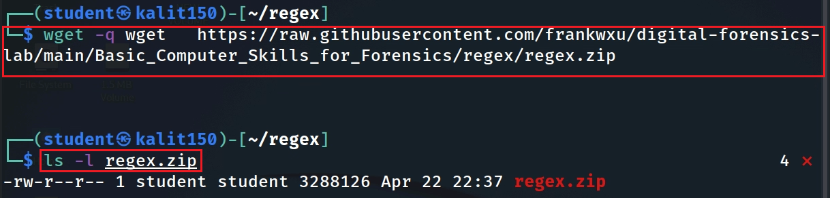
Download lab files
Notes:
wget https://raw.githubusercontent.com/frankwxu/digital-forensics-lab/main/Basic_Computer_Skills_for_Forensics/regex/regex.zip

Slide 5
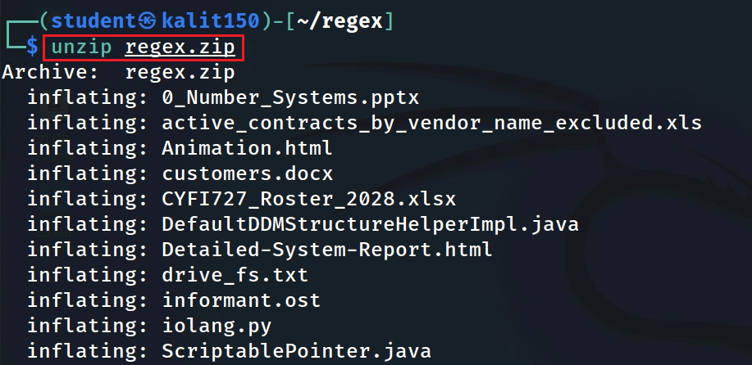
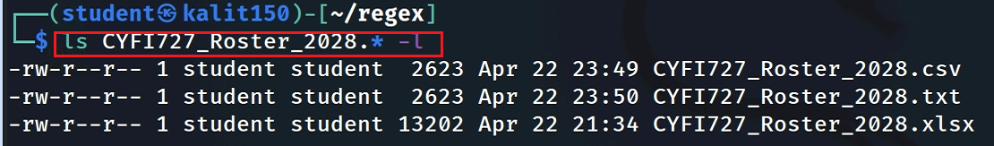
unzip the file
Verify some unzipped files

Slide 6
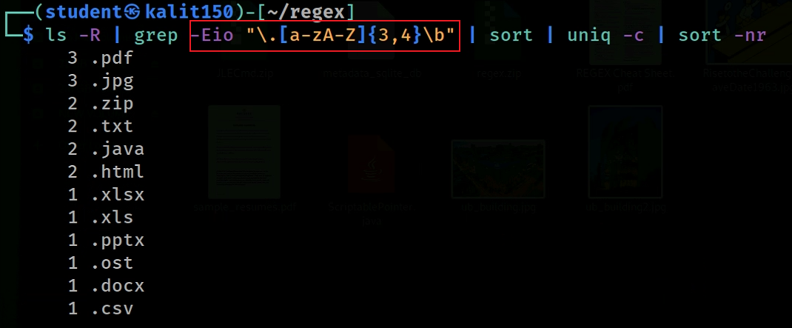
List all file types in the directory, including all sub-directories
Notes:
ls -R | grep -Eio "\.[a-zA-Z]{3,4}\b" | sort | uniq -c | sort -nr

Slide 7
File types
 | File Type | File Eextension | Tools
unzipped | text | .txt, .html, .java, .cpp, xml | grep
 | pdf | .pdf | pdfgrep
 | database | .db | Convert to text/grep -a
 | Outlook email | .ost | pffexport
 | Photo | .jpg | OCR
 | Video | .mp4 | OCR
 | audio | .wav | Deepspeech, htk
 | executable | .exe, .com, dll | grep -a
zipped | Compressed | .zip,.7z | unzip
 | proprietary format | .docx, .xlsx, pptx | Unzip , search xml
Notes:
https://github.com/darrentu/convert-db-to-csv
sqlite3 $db<<- EXIT_HERE .mode csv .headers on .output $i.csv SELECT * FROM $i; .exit EXIT_HERE

Slide 8
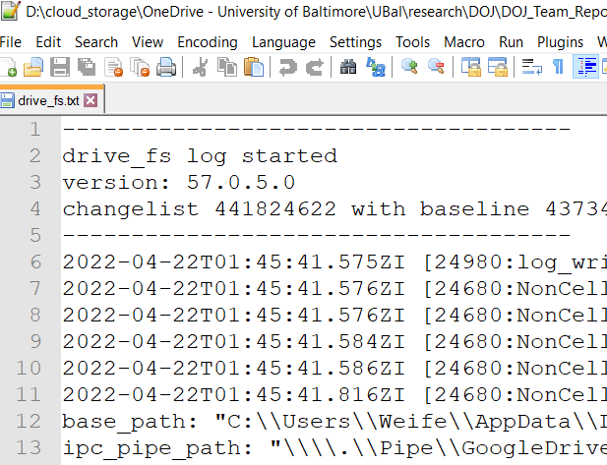
Content Types
ASCII code
human readable
can be viewed in Notepad or cat command
e.g., .txt, Java, HTML
Binary
not human readable
need special software to view the content
executable, special documents
.exe, .com, .jpg, .pdf
strings are readable

Slide 9
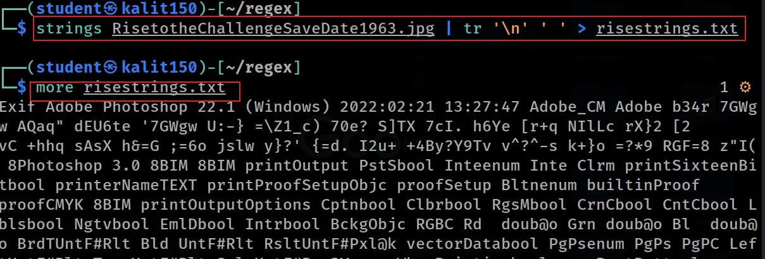
Save strings of a jpg to a txt file
Notes:
strings RisetotheChallengeSaveDate1963.jpg | tr '\n' ' ' > risestrings.txt
more risestrings.txt

Slide 10

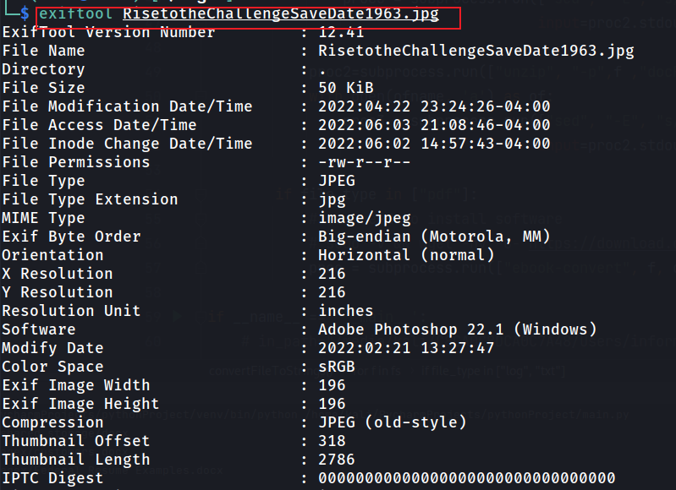
Install a tool
Show metadata

Slide 11
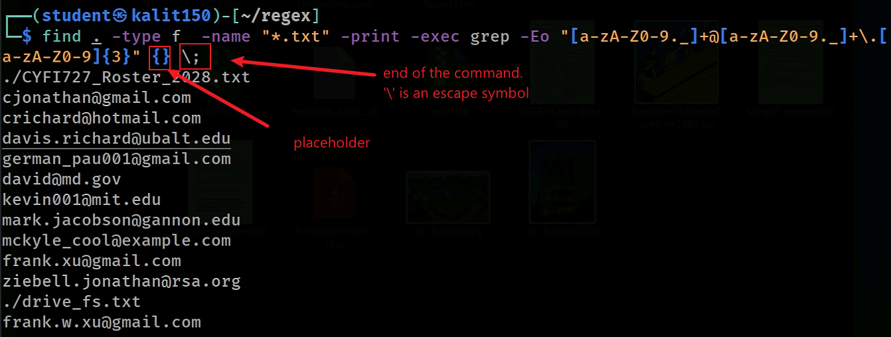
Search email in all text files
for each matched file
Notes:
find . -type f -name "*.txt" -print -exec grep -Eo "[a-zA-Z0-9._]+@[a-zA-Z0-9._]+\.[a-zA-Z0-9]{3}" {} \;

Slide 12
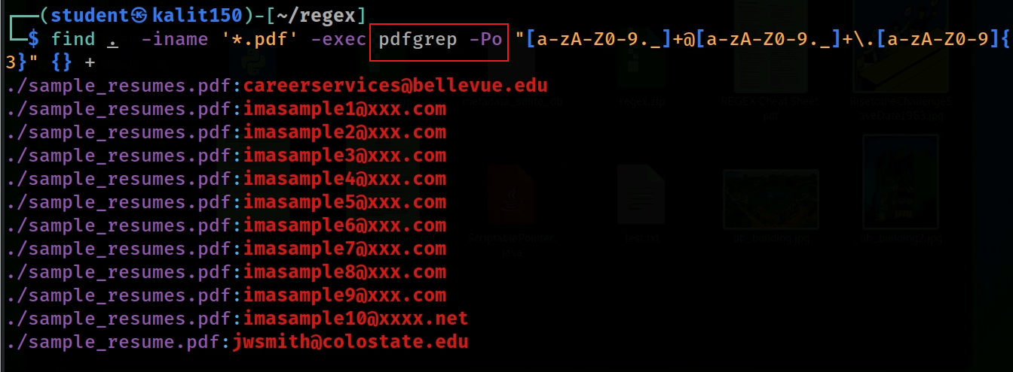
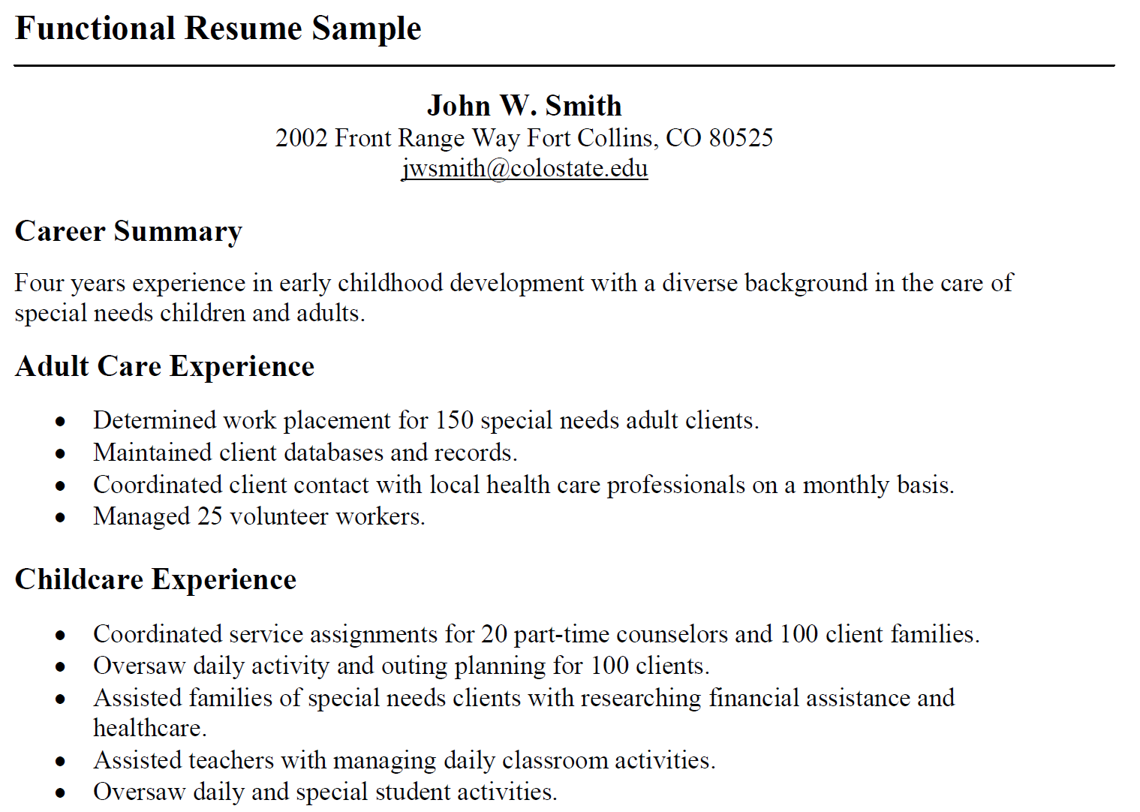
Search email in pdf files
sudo apt-get install -y pdfgrep
Notes:
sudo apt-get install -y pdfgrep

Slide 13
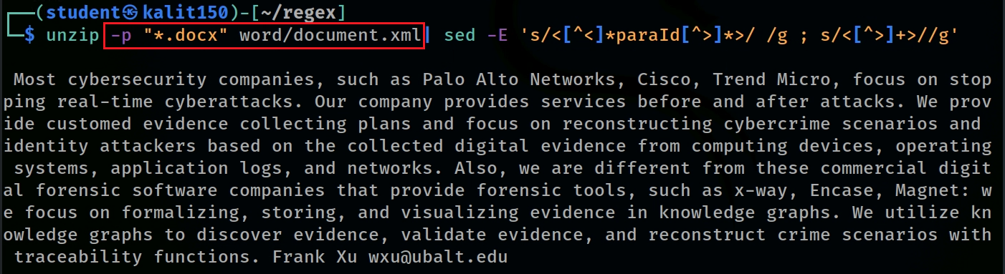
Show .docx content without unzip to disk
-p extract files to pipe, no messages
Show .docx props without unzip to disk
Notes:
unzip -p "*.docx" word/document.xml| sed -E 's/<[^<]*paraId[^>]*>/ /g ; s/<[^>]+>//g’
unzip -p "*.docx" docProps/core.xml| sed -E 's/<[^>]+>/ /g'

Slide 14
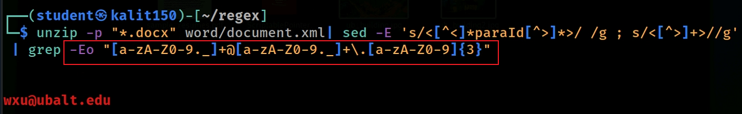

Show email in a .docx content without unzip to disk
Try multiple docx files
Notes:
unzip -p "*.docx" word/document.xml| sed -E 's/<[^<]*paraId[^>]*>/ /g ; s/<[^>]+>//g' | grep -Eo "[a-zA-Z0-9._]+@[a-zA-Z0-9._]+\.[a-zA-Z0-9]{3}"

Slide 15
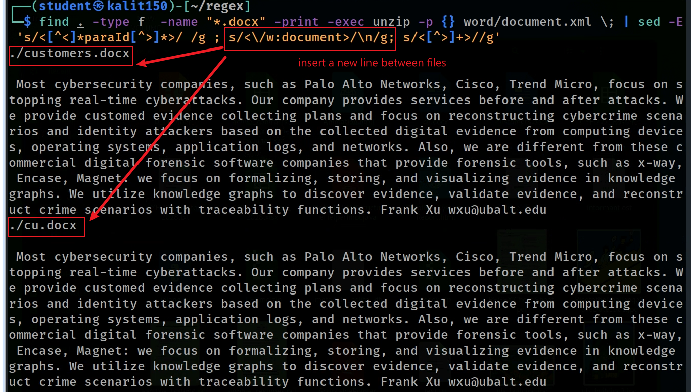
Only can search word/document.xml
Notes:
find . -type f -name "*.docx" -print -exec unzip -p {} word/document.xml \; | sed -E 's/<[^<]*paraId[^>]*>/ /g ; s/<\/w:document>/\n/g; s/<[^>]+>//g'

Slide 16
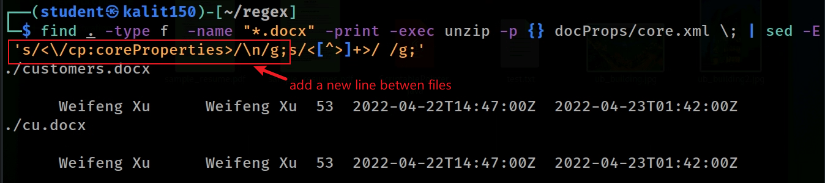
Only can search docPropos/core.xml
Notes:
find . -type f -name "*.docx" -print -exec unzip -p {} docProps/core.xml \; | sed -E 's/<\/cp:coreProperties>/\n/g;s/<[^>]+>/ /g;'

Slide 17
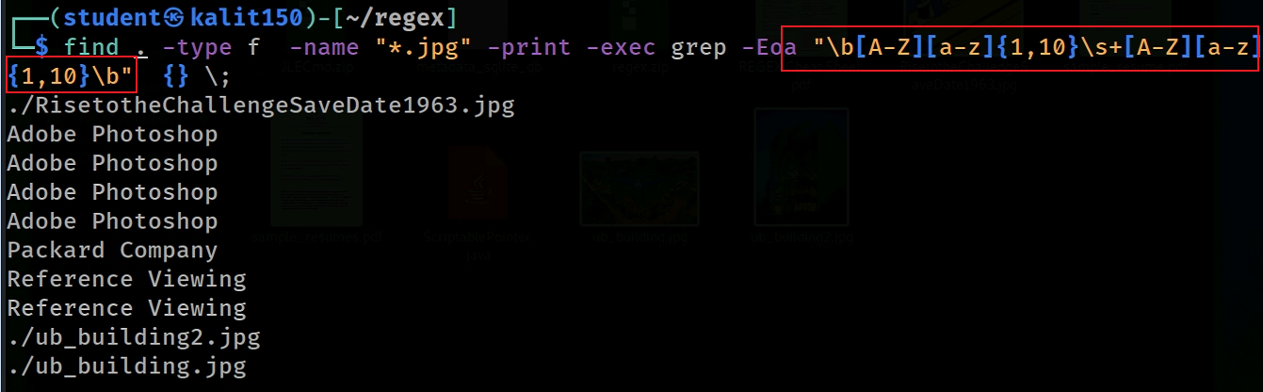
use space “ ”
Search people’ names in images (mainly header or hidden names)
People’s names have patterns, however, the results are inaccurate
Notes:
find . -type f -name "*.jpg" -print -exec grep -Eoa "\b[A-Z][a-z]{1,10} +[A-Z][a-z]{1,10}\b" {} \;

Slide 18
calibre conversion

Slide 19
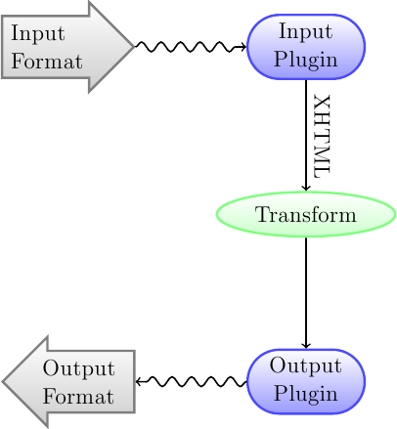
calibre
Convert an e-book from one format to another.
The output e-book format is guessed from the file extension of output_file.
We use the software to convert files with different format to text file.
supported: docx, pdf
not supported: xlsx, pptx
Notes:
https://manual.calibre-ebook.com/conversion.html

Slide 20
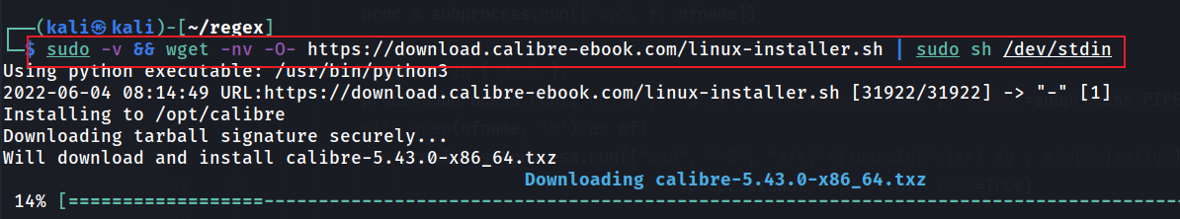
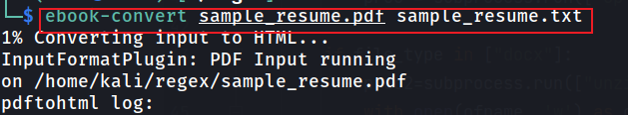
Install calibre to convert pdf to text
convert pdf to text
Notes:
sudo -v && wget -nv -O- https://download.calibre-ebook.com/linux-installer.sh | sudo sh /dev/stdin
ebook-convert sample_resume.pdf sample_resume.txt
https://calibre-ebook.com/download_linux
https://unix.stackexchange.com/questions/4759/is-there-some-sort-of-pdf-to-text-converter

Slide 21
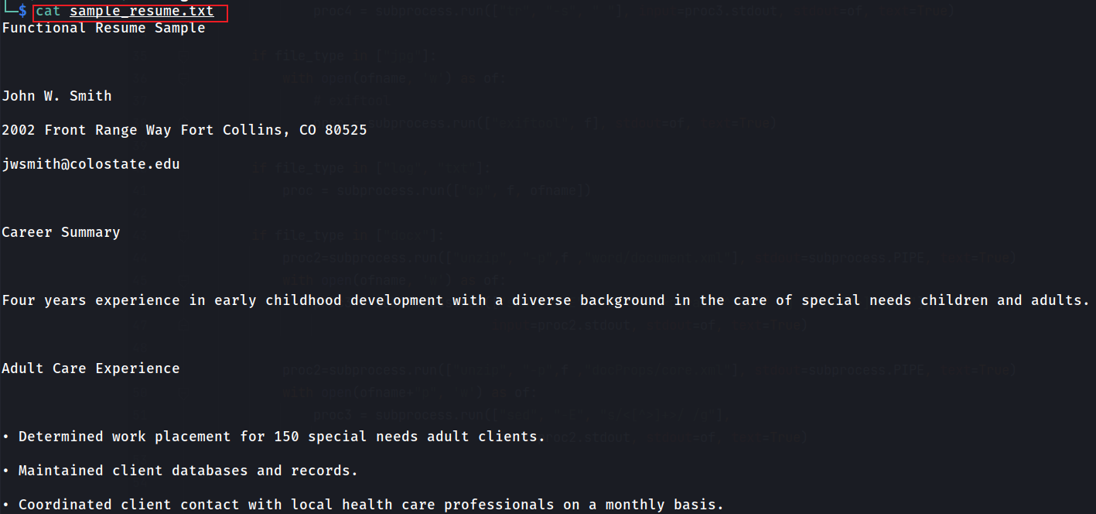
Show converted txt file
Notes:
cat sample_resume.txt

Slide 22
Search Data Leakage image

Slide 23
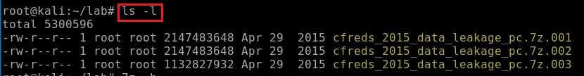
How to download the DD image?
Download DD images. See notes if the link expired
Repeat wget command to download .002 and .003
https://cfreds-archive.nist.gov/data_leakage_case/images/pc/cfreds_2015_data_leakage_pc.7z.001
https://cfreds-archive.nist.gov/data_leakage_case/images/pc/cfreds_2015_data_leakage_pc.7z.002
https://cfreds-archive.nist.gov/data_leakage_case/images/pc/cfreds_2015_data_leakage_pc.7z.003
Verify three zipped files
Notes:
Backup links
https://www.dropbox.com/s/u4axlx8eomgwfdc/cfreds_2015_data_leakage_pc.7z.001
https://www.dropbox.com/s/pyq50s2cri6yftf/cfreds_2015_data_leakage_pc.7z.002
https://www.dropbox.com/s/cxvzuiupmqc7l99/cfreds_2015_data_leakage_pc.7z.003

Slide 24
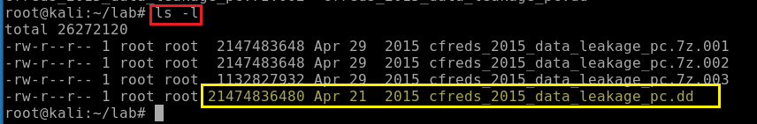
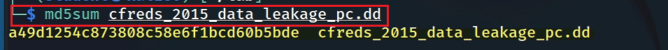
unzipped the DD image
Verify the unzipped DD image
Verify the unzipped DD image with MD5
Notes:
7z e cfreds_2015_data_leakage_pc.7z.001

Slide 25
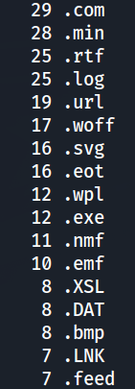
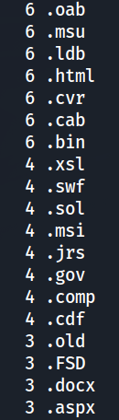
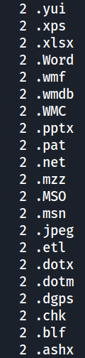
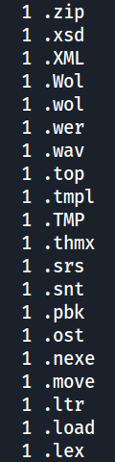
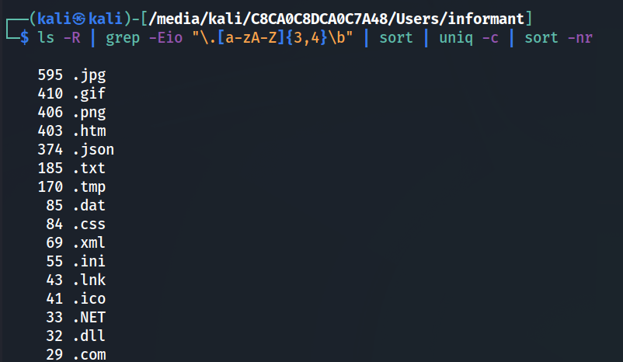
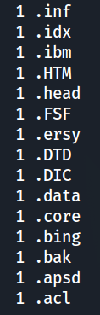
Types of files
Notes:
ls -R | grep -Eio "\.[a-zA-Z]{3,4}\b" | sort | uniq -ic | sort -nr

Slide 26
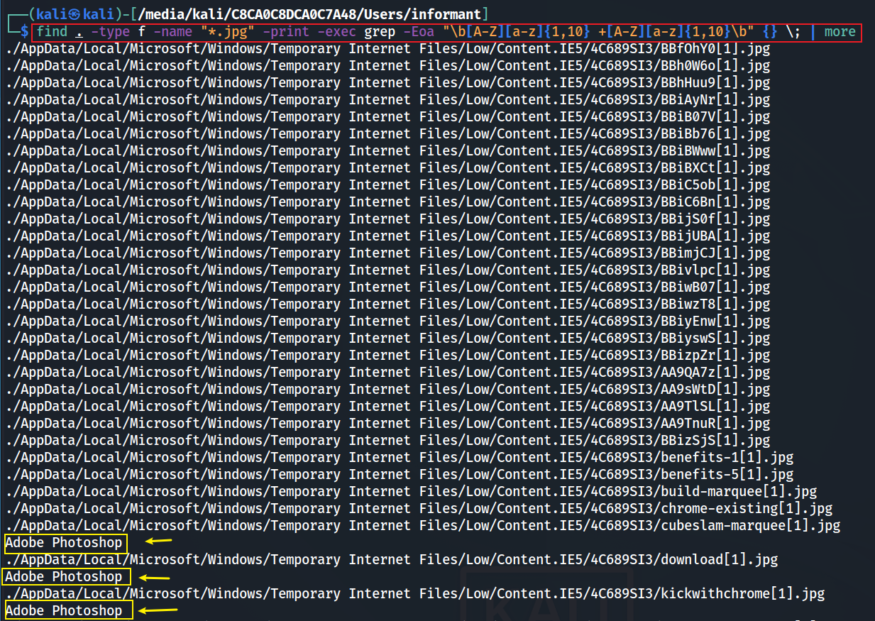
Notes:
find . -type f -name "*.jpg" -print -exec grep -Eoa "\b[A-Z][a-z]{1,10} +[A-Z][a-z]{1,10}\b" {} \; | more

Slide 27
Search ios image
see An Introduction to iOS 13 Image
Notes:
wget –q https://digitalcorpora.s3.amazonaws.com/corpora/mobile/ios_13_4_1/ios_13_4_1.zip

Slide 28
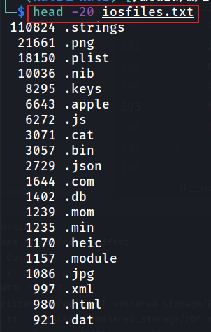
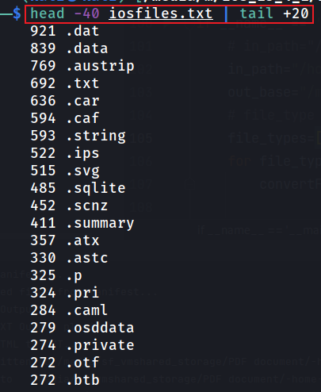
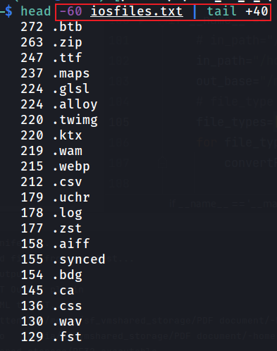
Types of files based on file extension (1 - 7 chars)
%f File's name with any leading directories removed
Show first 20 lines
Show first 20 -40 lines
Show first 40-60 lines
Notes:
find . -type f -name "*.*" | grep -Eio "\.[a-zA-Z]{1,7}\b" | sort | uniq -ic | sort -nr > iosfiles.txt
head -40 iosfiles.txt | tail +20
https://explainshell.com/explain?cmd=find%20%2Fusr%2Finclude%20-printf%20%25P%5C%5Cn%20%3E%20found_files

